Slide 1
Calpain10 (CAPN10): Unraveling its Significance in Polycystic Ovary Syndrome (PCOS) and Insulin Resistance
Meena Easwaran
Dec 08, 2023

Slide 2
Outline of Presentation
Background
Motivation
Study Objectives
Specific Aims
Methodology
Results
Summary
Take-Home Messages

Slide 3
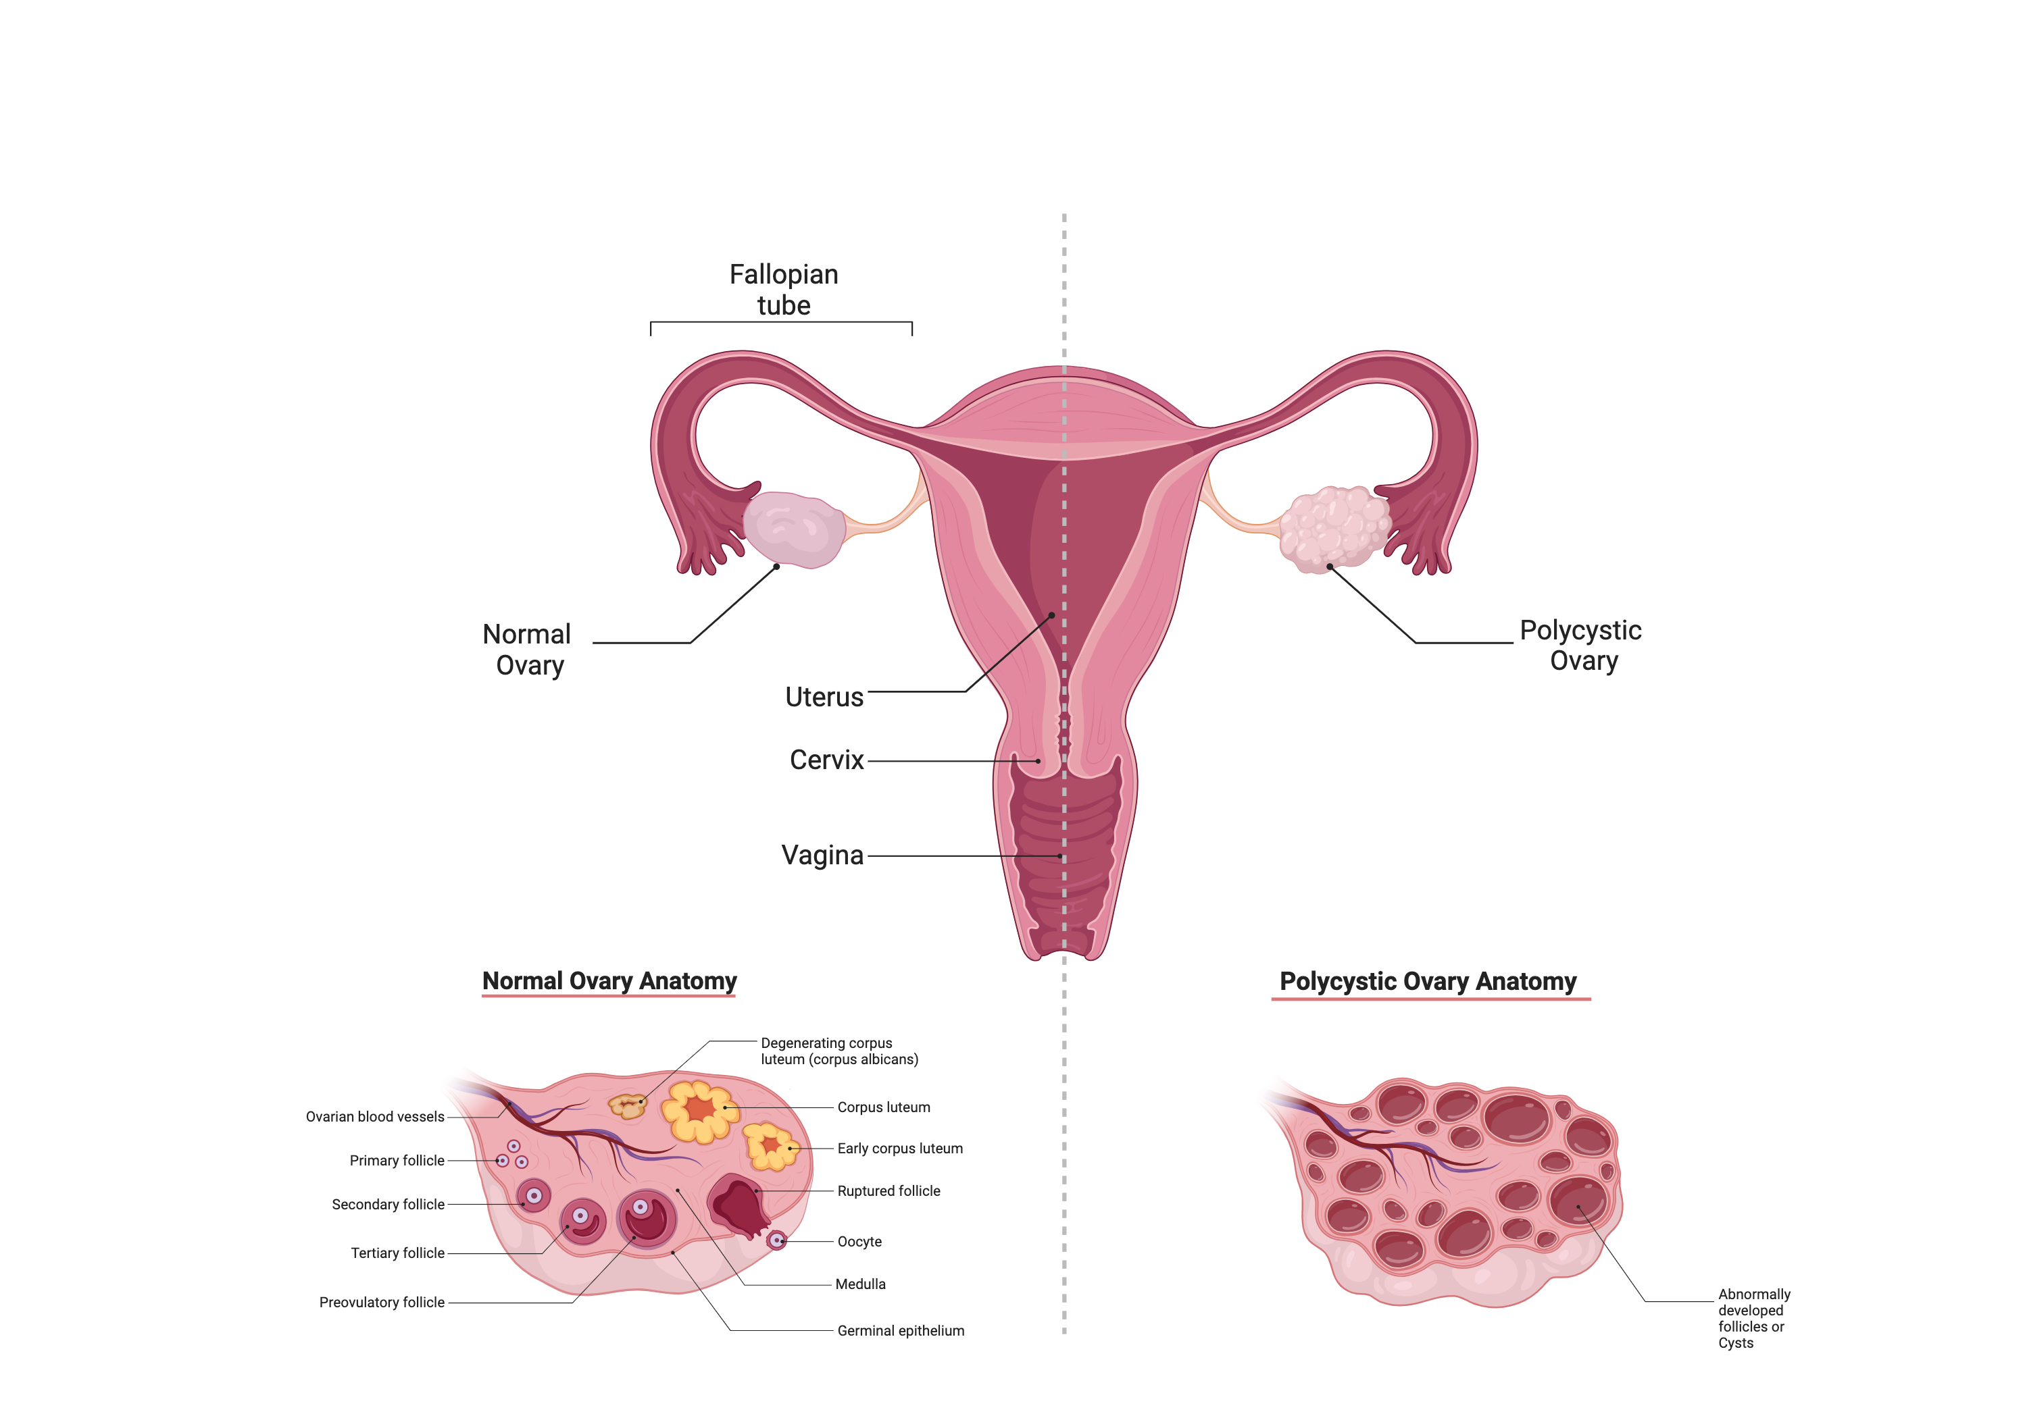
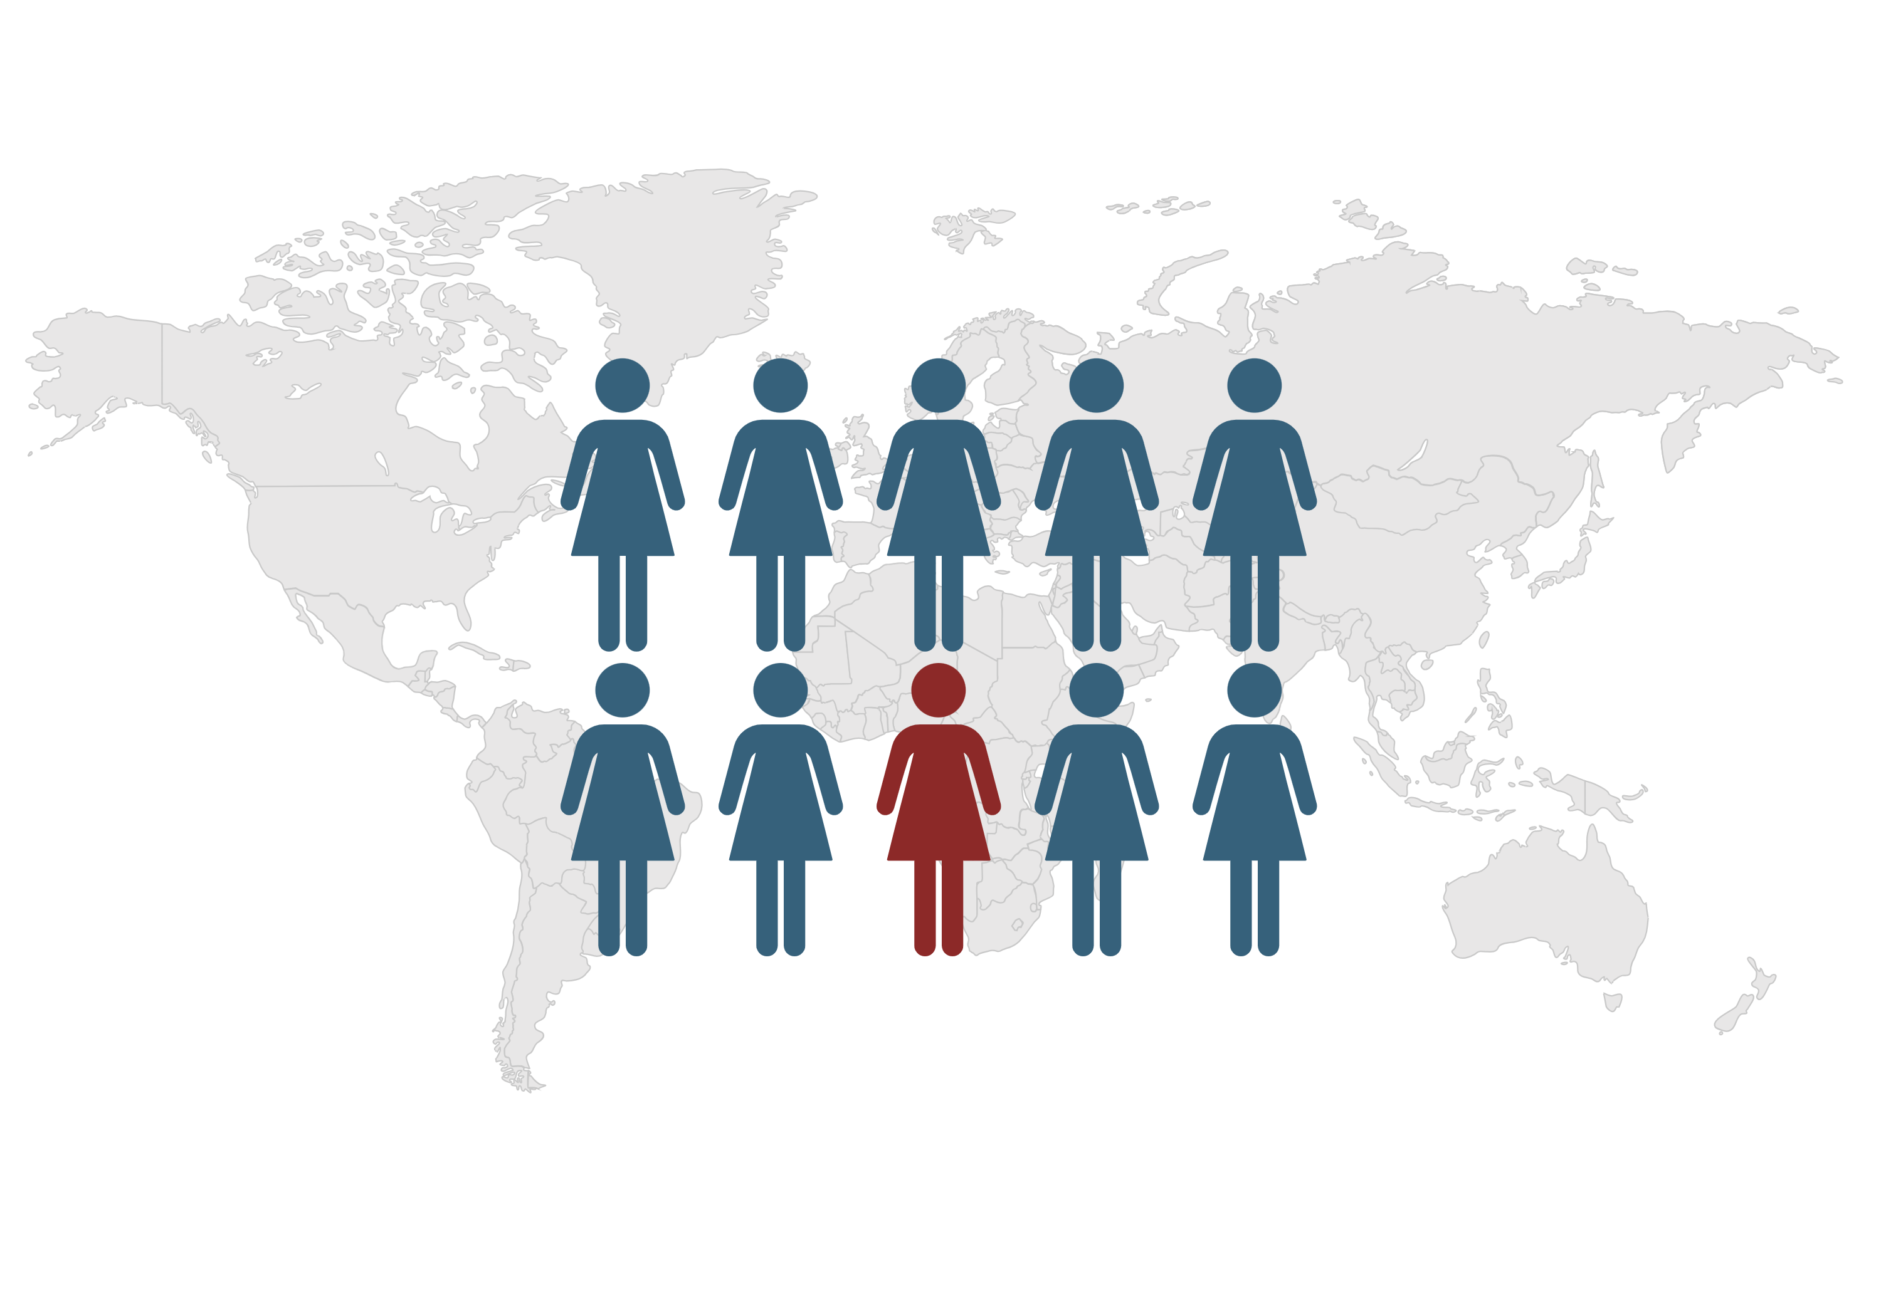
Background: Polycystic Ovary Syndrome (PCOS)
Reproductive endocrine disorder
Affects 1 in 10 women in reproductive age worldwide
First identified by Vallisneri, a Italian medical scientist in 1721
Stein-Leventhal syndrome (1935)
Created with BioRender
Witchel SF, Azziz R, Oberfield SE. History of Polycystic Ovary Syndrome, Premature Adrenarche, and Hyperandrogenism in Pediatric Endocrinology. Horm Res Paediatr. 2022;95:557–67

Slide 4
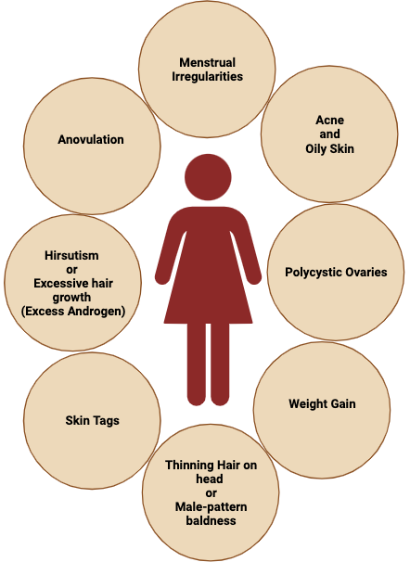
Background: PCOS Symptoms and Diagnoses
Classification of PCOS Phenotypes
PCOS Phenotype | Characteristics |  |  | Other nomenclature
 | Anovulation | Hyperandrogenism | Polycystic Ovary
1/A | Yes | Yes | Yes | Complete or Full-blown PCOS
2/B | Yes | Yes | No | Non polycystic ovary PCOS
3/C | No | Yes | Yes | Ovulatory PCOS
4/D | Yes | No | Yes | Non-hyperandrogenic PCOS
Created with BioRender
Panidis D, Tziomalos K, Misichronis G, Papadakis E, Betsas G, Katsikis I, et al. Insulin resistance and endocrine characteristics of the different phenotypes of polycystic ovary syndrome: a prospective study. Hum Reprod. 2012;27:541–9

Slide 5
Background: PCOS Symptoms and Diagnoses
Classification of PCOS Phenotypes
PCOS Phenotype | Characteristics |  |  | Other nomenclature
 | Anovulation | Hyperandrogenism | Polycystic Ovary
1/A | Yes | Yes | Yes | Complete or Full-blown PCOS
2/B | Yes | Yes | No | Non polycystic ovary PCOS
3/C | No | Yes | Yes | Ovulatory PCOS
4/D | Yes | No | Yes | Non-hyperandrogenic PCOS
Multiphenotypic disorder
Created with BioRender
Panidis D, Tziomalos K, Misichronis G, Papadakis E, Betsas G, Katsikis I, et al. Insulin resistance and endocrine characteristics of the different phenotypes of polycystic ovary syndrome: a prospective study. Hum Reprod. 2012;27:541–9

Slide 6
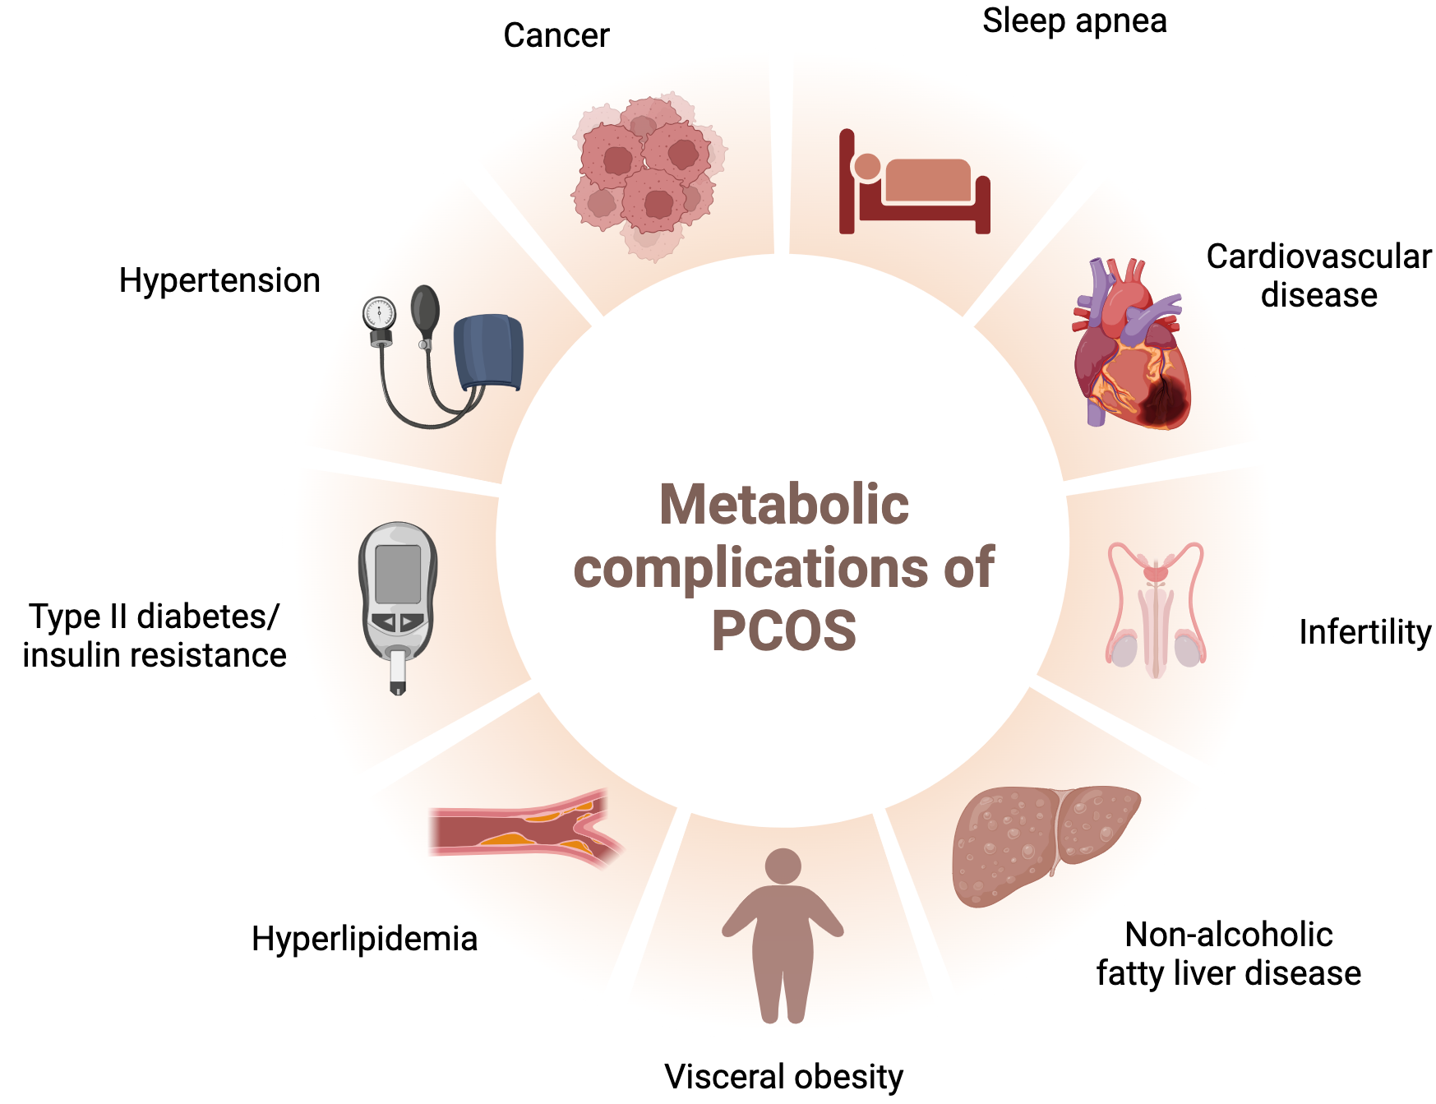
Background: Metabolic Complications of PCOS
Created with BioRender
Azziz R. Reproductive endocrinology and infertility: Clinical expert series polycystic ovary syndrome. Obstet Gynecol. 2018;132:321–36

Slide 7
Background: PCOS Causes and Treatment
Causes
Treatment
Comprehensive approach
Lifestyle changes
Dietary changes
Weight management
Medication for associated conditions
Birth control pills to regulate cycles
Insulin-sensitizing medicine like Metformin
Androgen blockers
Exact cause is poorly understood
Possible causes
Genetic inheritance
Environmental, occupational, and lifestyle factors
Govind A, Obhrai MS, Clayton RN. Polycystic Ovaries Are Inherited as an Autosomal Dominant Trait: Analysis of 29 Polycystic Ovary Syndrome and 10 Control Families. J Clin Endocrinol Metab. 1999;84:38–43.
Khan MJ, Ullah A, Basit S. Genetic Basis of Polycystic Ovary Syndrome (PCOS): Current Perspectives. Appl Clin Genet. 2019;12:249
Kshetrimayum C, Sharma A, Mishra VV, Kumar S. Polycystic ovarian syndrome: Environmental/occupational, lifestyle factors; an overview. J Turkish Ger Gynecol Assoc. 2019;20:255

Slide 8

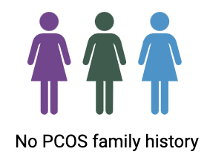
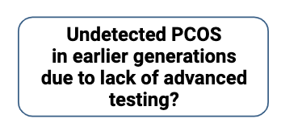
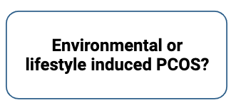
Motivation: Selecting PCOS
Personal motivation: PCOS cyster
or
Created with BioRender

Slide 9
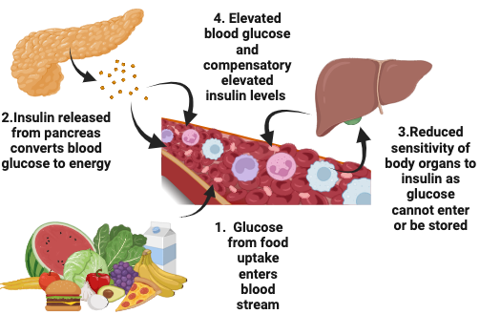
Motivation: Selecting PCOS-induced Insulin Resistance
Personal motivation: Diagnosed with Insulin resistance (IR)
Insulin Resistance
Type 2 Diabetes Mellitus
Classification of PCOS Phenotypes
PCOS Phenotype | Characteristics |  |  | Other nomenclature | Incidence of Insulin resistance
 | Anovulation | Hyperandrogenism | Polycystic Ovary
1/A | Yes | Yes | Yes | Complete or Full-blown PCOS | Yes
2/B | Yes | Yes | No | Non polycystic ovary PCOS | Yes
3/C | No | Yes | Yes | Ovulatory PCOS | No
4/D | Yes | No | Yes | Non-hyperandrogenic PCOS | Yes
Created with BioRender as an adaption from https://www.clairepettitt.com/blog/pcos-and-insulin-resistance
Panidis D, Tziomalos K, Misichronis G, Papadakis E, Betsas G, Katsikis I, et al. Insulin resistance and endocrine characteristics of the different phenotypes of polycystic ovary syndrome: a prospective study. Hum Reprod. 2012;27:541–9

Slide 10
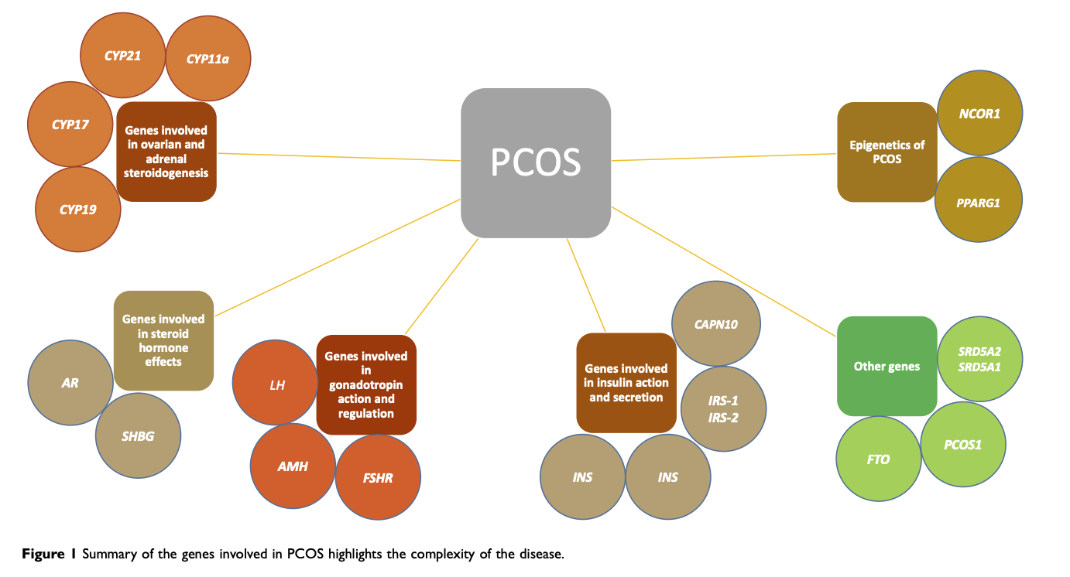
Motivation: Selecting PCOS-induced Insulin Resistance Candidate Gene
CALPAIN 10
First gene associated with Type 2 Diabetes Mellitus
Khan,M.J., Ullah,A. and Basit,S. (2019) Genetic Basis of Polycystic Ovary Syndrome (PCOS): Current Perspectives. Appl. Clin. Genet., 12, 249
Ridderstråle M, Nilsson E. Type 2 diabetes candidate gene CAPN10: First, but not last. Curr Hypertens Rep. 2008;10:19–24.

Slide 11
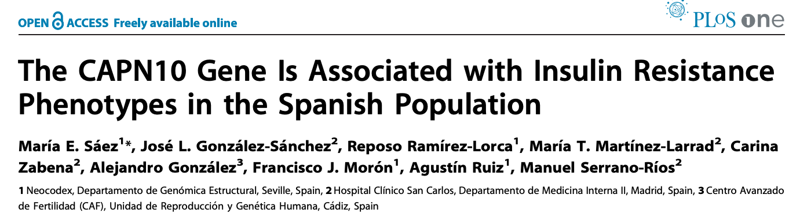
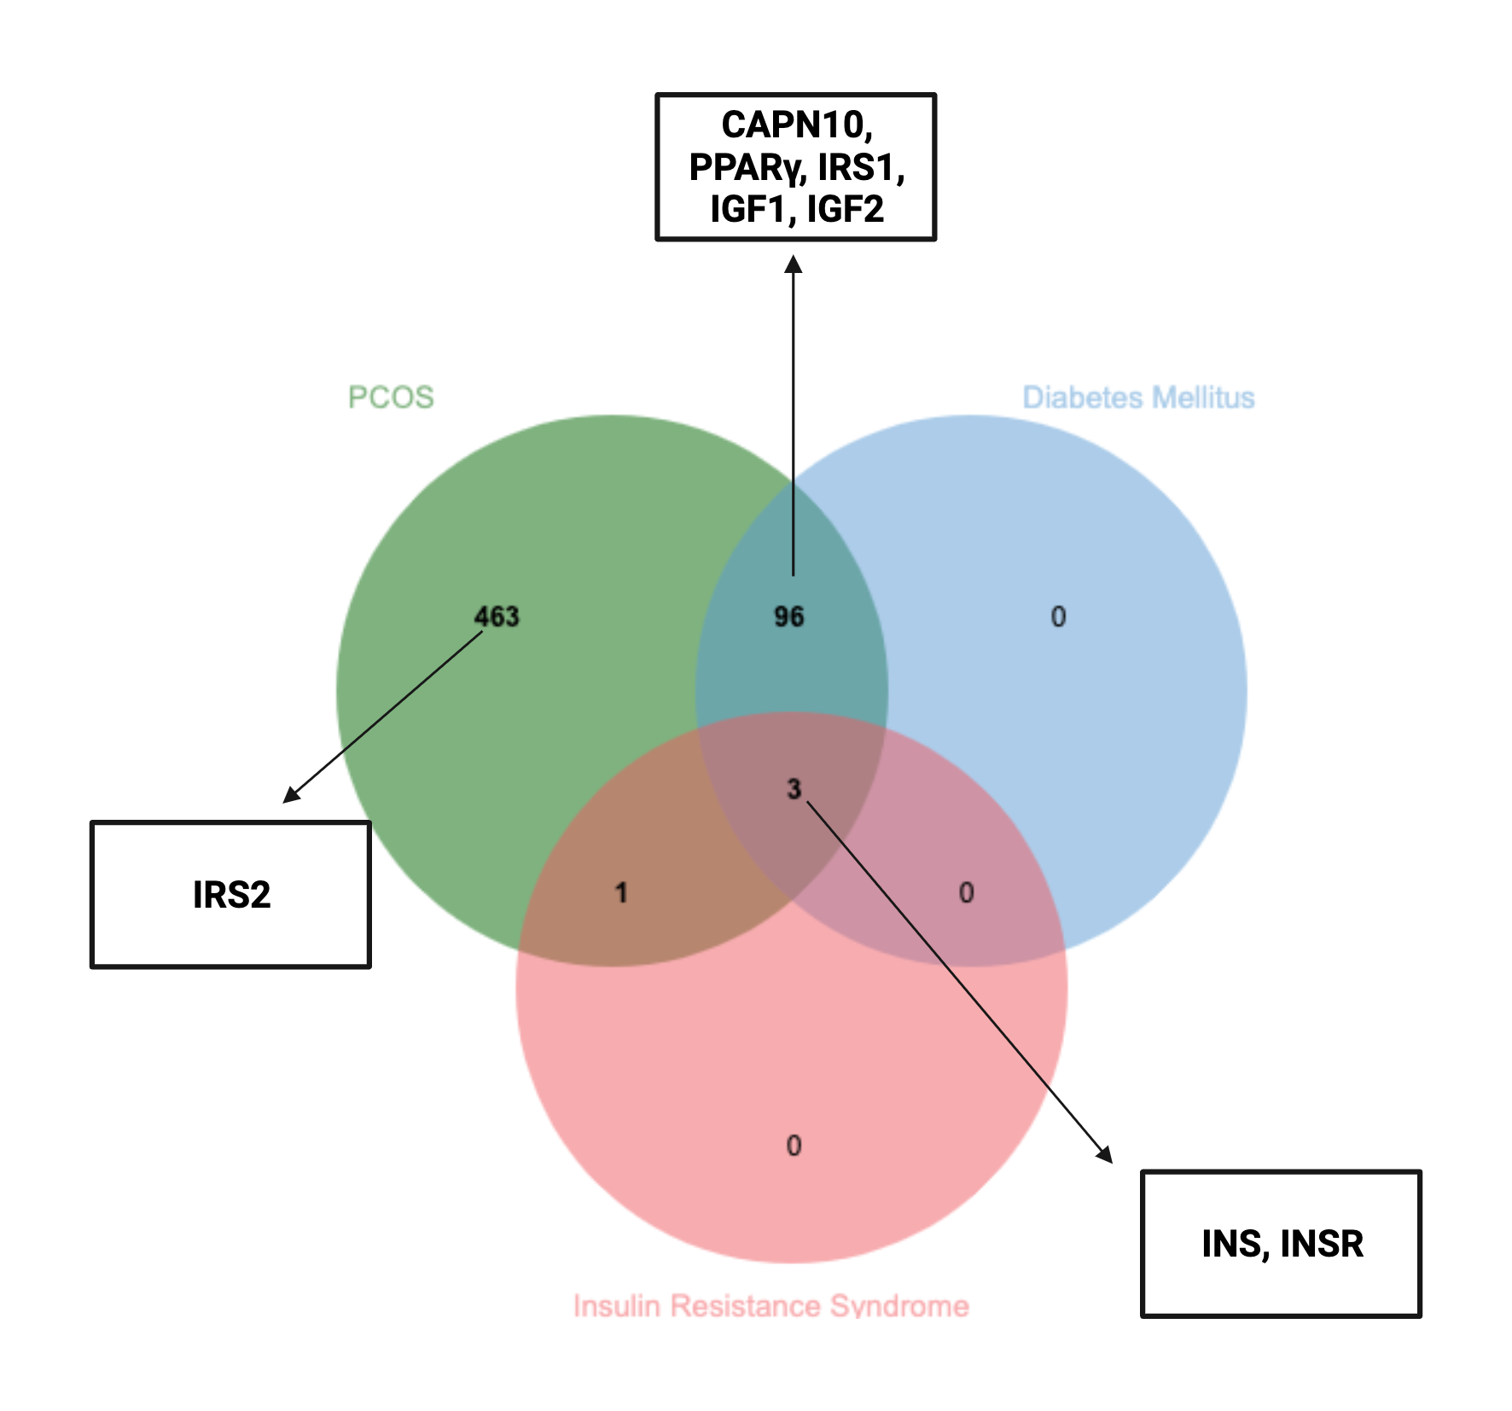
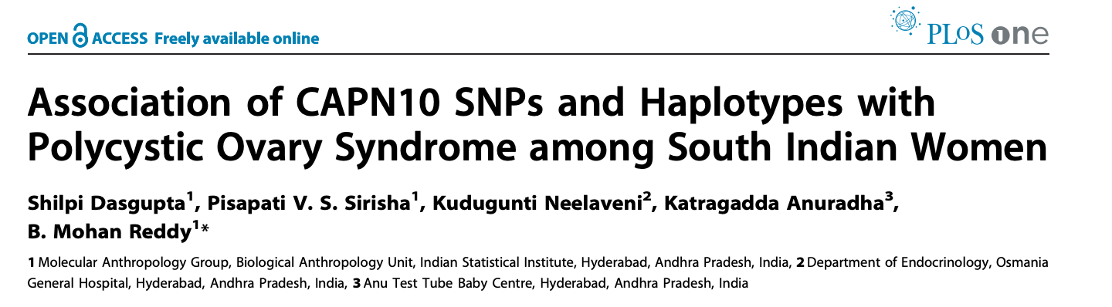
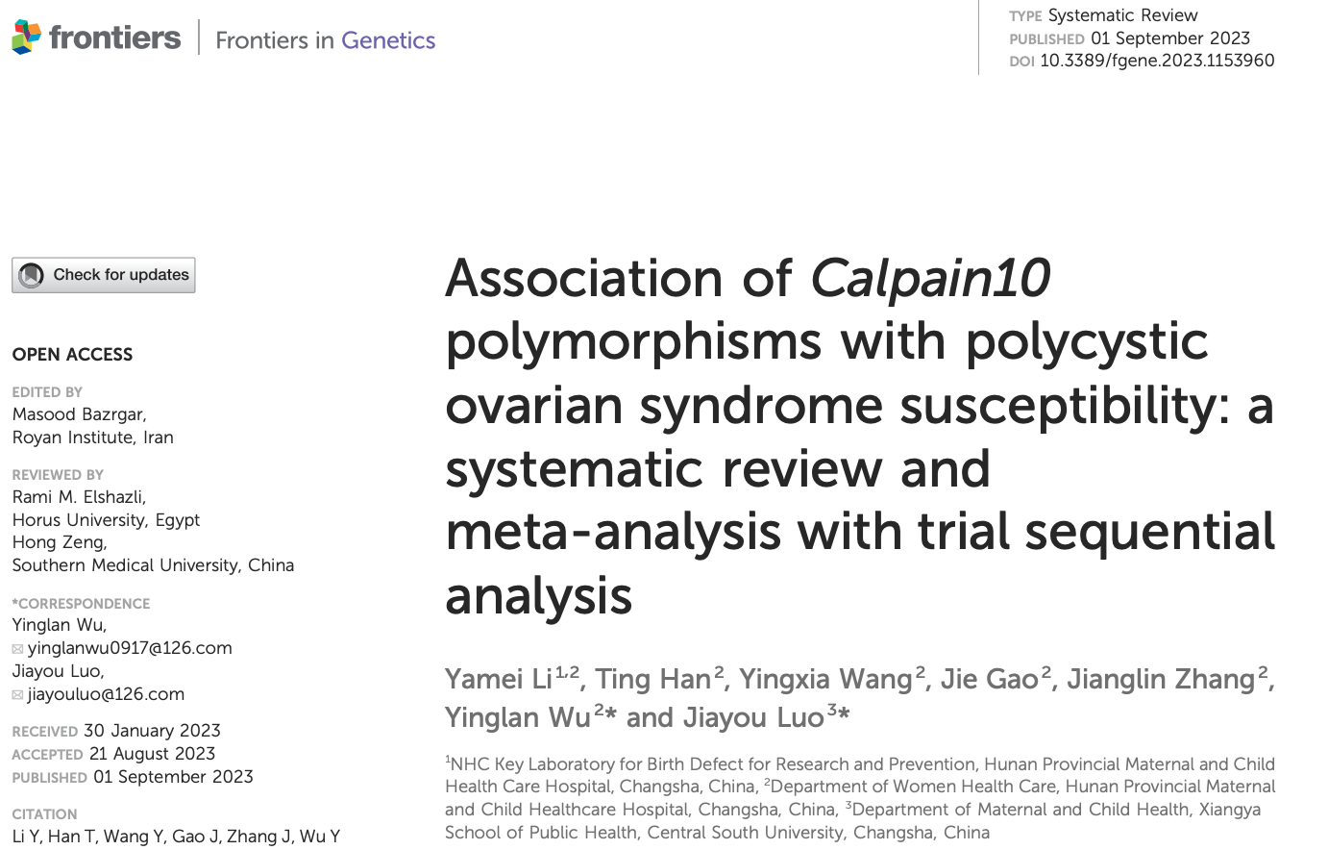
Motivation: Selecting PCOS-induced Insulin Resistance Candidate Gene
Joseph,S., Barai,R.S., Bhujbalrao,R. and Idicula-Thomas,S. (2016) PCOSKB: A KnowledgeBase on genes, diseases, ontology terms and biochemical pathways associated with PolyCystic Ovary Syndrome. Nucleic Acids Res., 44, D1032–D1035

Slide 12
Study Objectives
To dissect the possible role of CAPN10 gene in predisposing women with PCOS to insulin resistance (IR)

Slide 13
Specific Aims
To evaluate the expression levels of CAPN10 gene across different tissues
To examine the inter-species evolutionary history and conservation of CAPN10
To identify genetic variations in CAPN10
To explore how genetic variations are associated with the PCOS phenotypes of IR and Type 2 Diabetes Mellitus
To perform differential expression and subsequent functional gene enrichment analysis on NCBI Gene Expression Omnibus (GEO) PCOS datasets between and to screen for CAPN10 expression patterns

Slide 14



CAPN10 Gene Expression in Human Tissues
https://www.proteinatlas.org/
https://gtexportal.org/home/
https://www.ebi.ac.uk/gxa/home

Slide 15
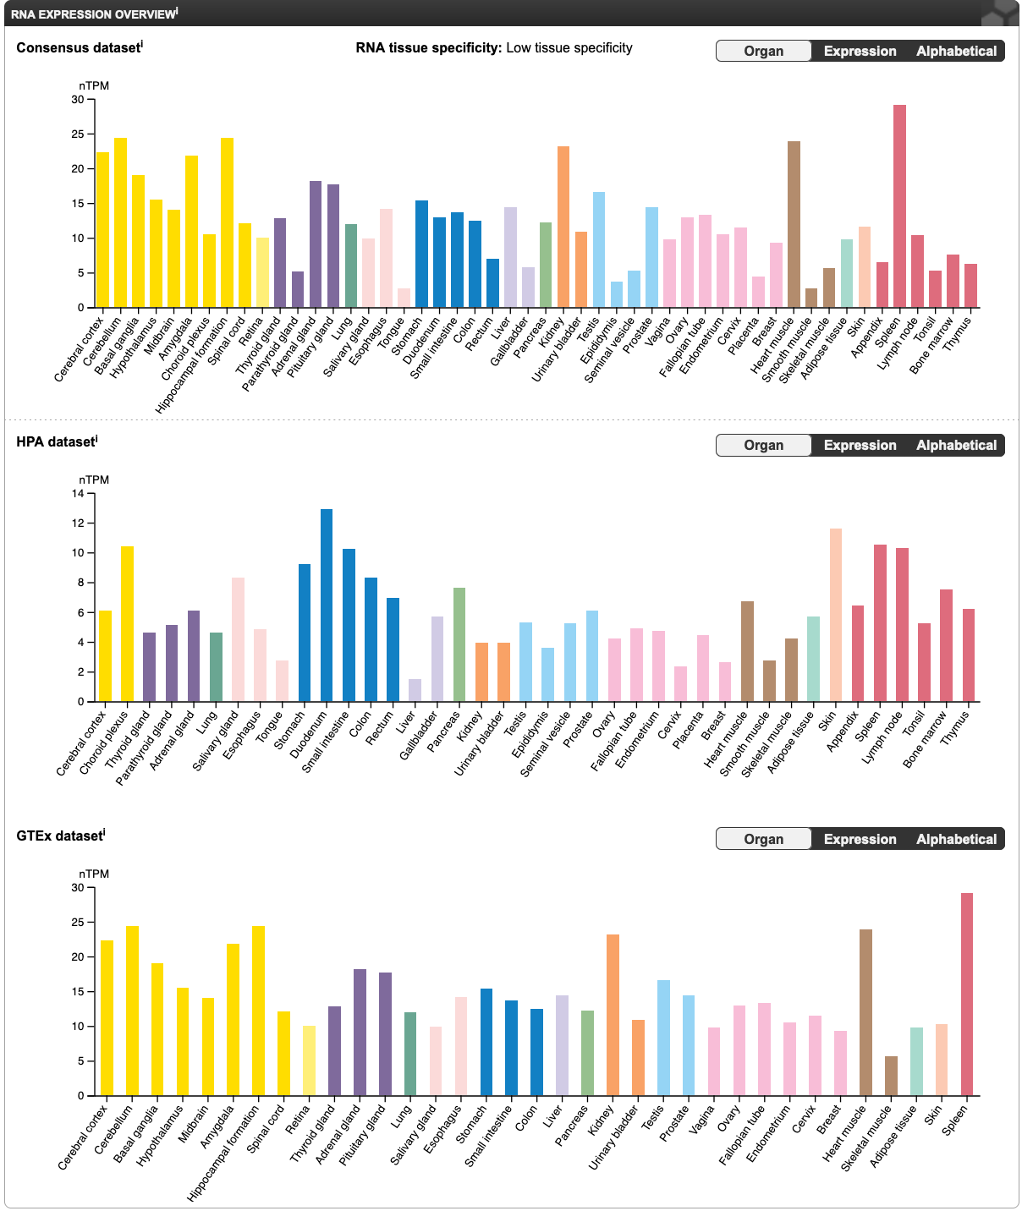
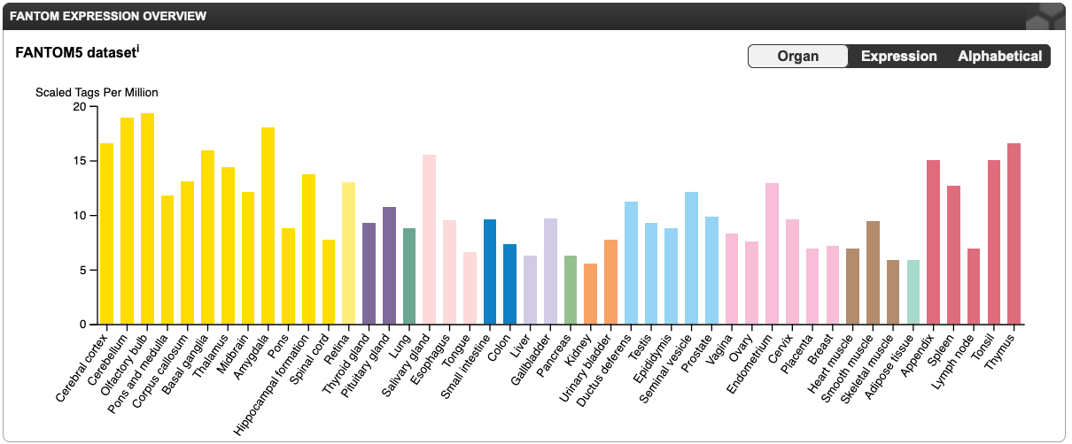
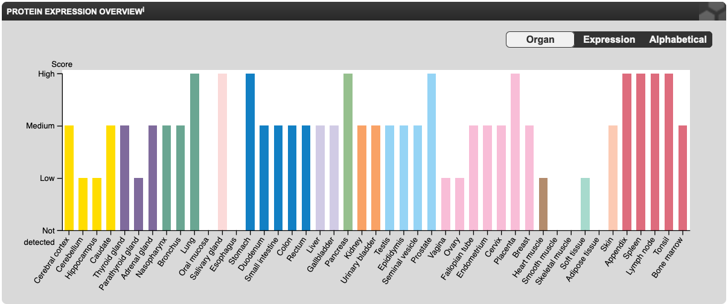
HPA

Slide 16
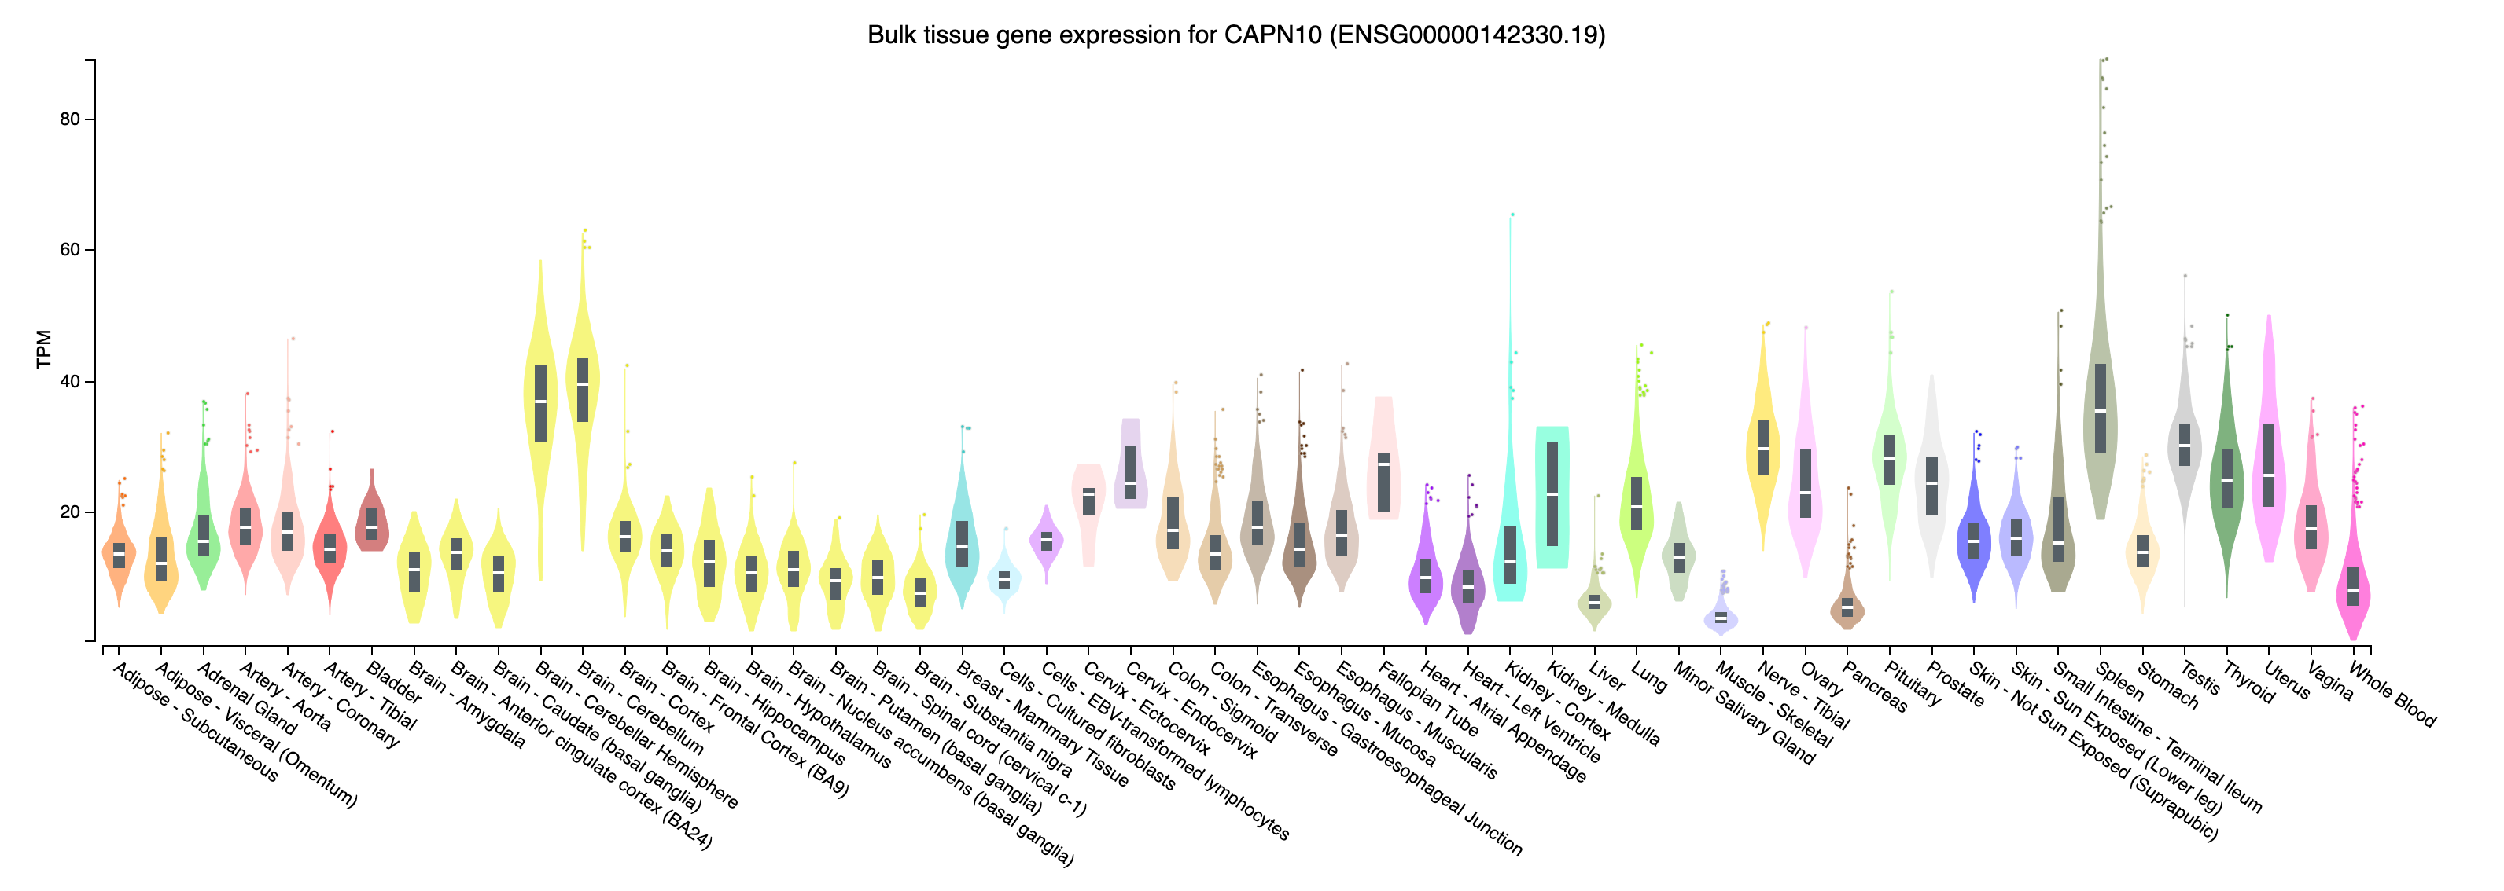
GTEx

Slide 17
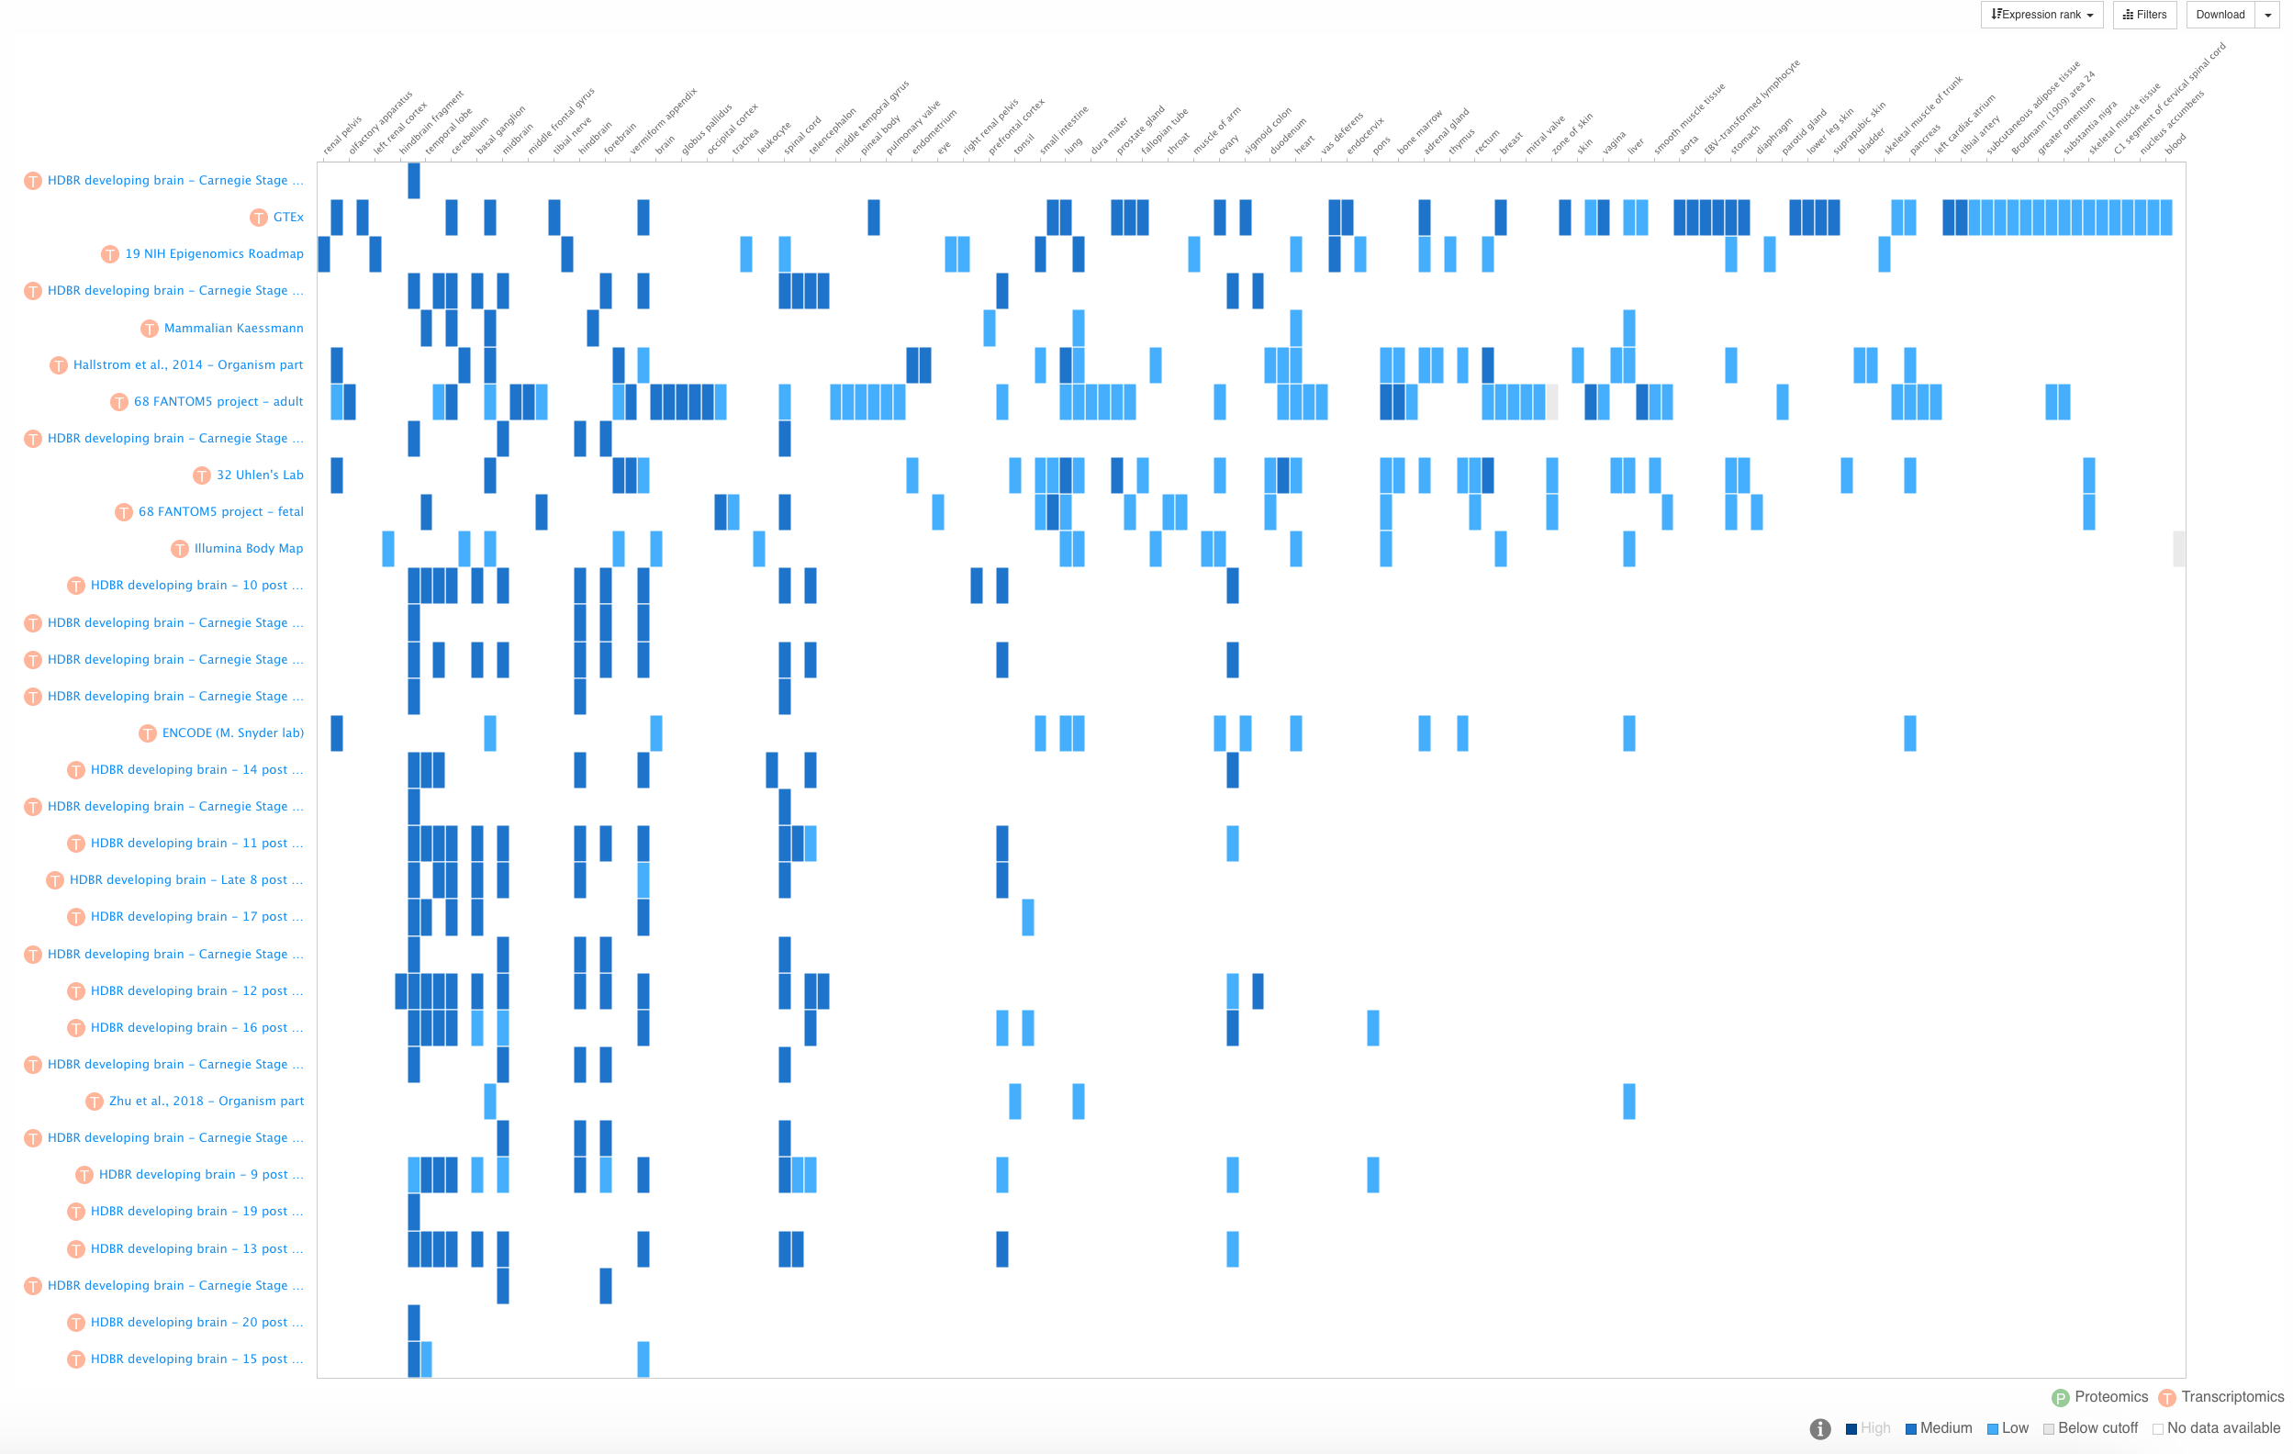
EMBL-EBI Expression Atlas
CAPN10 gene is found to be expressed in multiple tissue types

Slide 18
Examining Inter-species Conservation of CAPN10
Rodent models have been extensively used to study PCOS
Do not naturally exhibit PCOS-like symptoms
PCOS is a human condition characterized by hyperandrogenism
Requires external intervention for research purposes
Androgen induction
Other genetic/dietary/chemical or environmental perturbations
PCOS-like features have been naturally seen in monkeys, cow, dogs, and pigs
Most lack hyperandrogenism
IR is also conserved well across species
Erol A. Insulin resistance is an evolutionarily conserved physiological mechanism at the cellular level for protection against increased oxidative stress. Bioessays. 2007;29:811–8
Dunn AJ. Animal Models in Polycystic Ovarian Syndrome. Clin Obstet Gynecol. 2021;64:126–33
Ryu Y, Kim SW, Kim YY, Ku SY. Animal Models for Human Polycystic Ovary Syndrome (PCOS) Focused on the Use of Indirect Hormonal Perturbations: A Review of the Literature. Int J Mol Sci. 2019;2
Stener-Victorin E. Update on Animal Models of Polycystic Ovary Syndrome. Endocrinology. 2022;163

Slide 19

Examining Inter-species Conservation of CAPN10
Animal models of PCOS
Mouse
Rat
Rhesus monkey
Cow
Dog
Pig
All species available

Slide 20
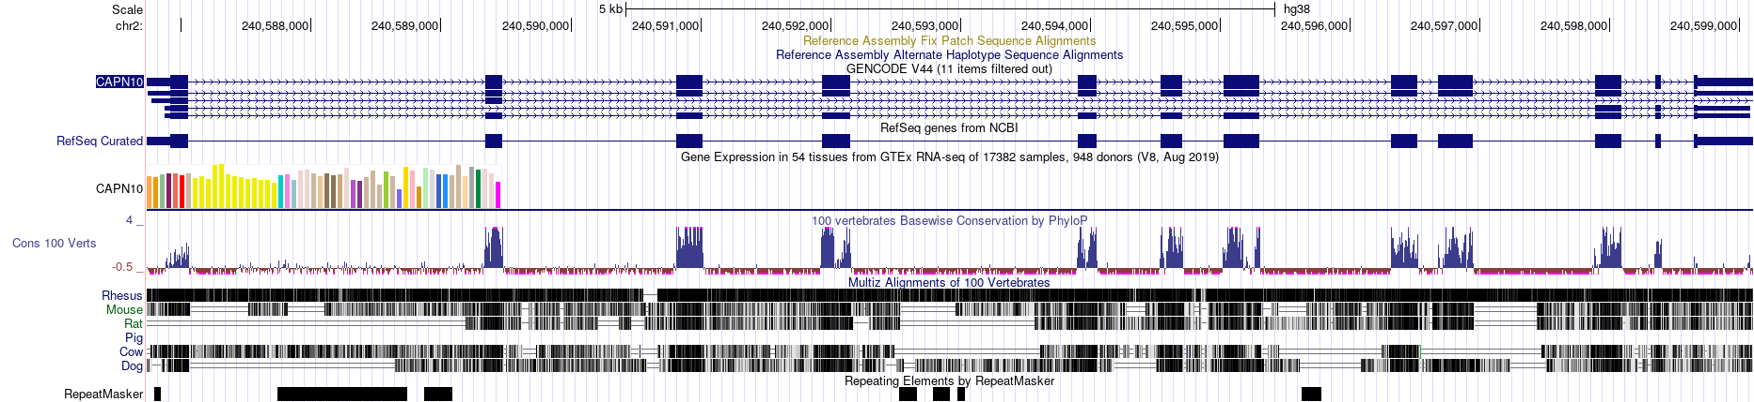
Conservation of CAPN10: PCOS animal models
Notes:
(CLICK) Calpain 10 gene has 12 exon or coding regions and has 11 intron or noncoding regions.
(CLICK) On either ends of the exon 1 and 12 are untranslated regions or UTR, which do not code for proteins.
(CLICK) Now, if you look down, the conservation status of each animal species is shown w.r.t human.
Apart from pig, rest of the species used as laboratory models show some mapping.
(CLICK-2X) Exonic regions show good conservation across species as indicated by blue peaks here, except for exon 12.

Slide 21
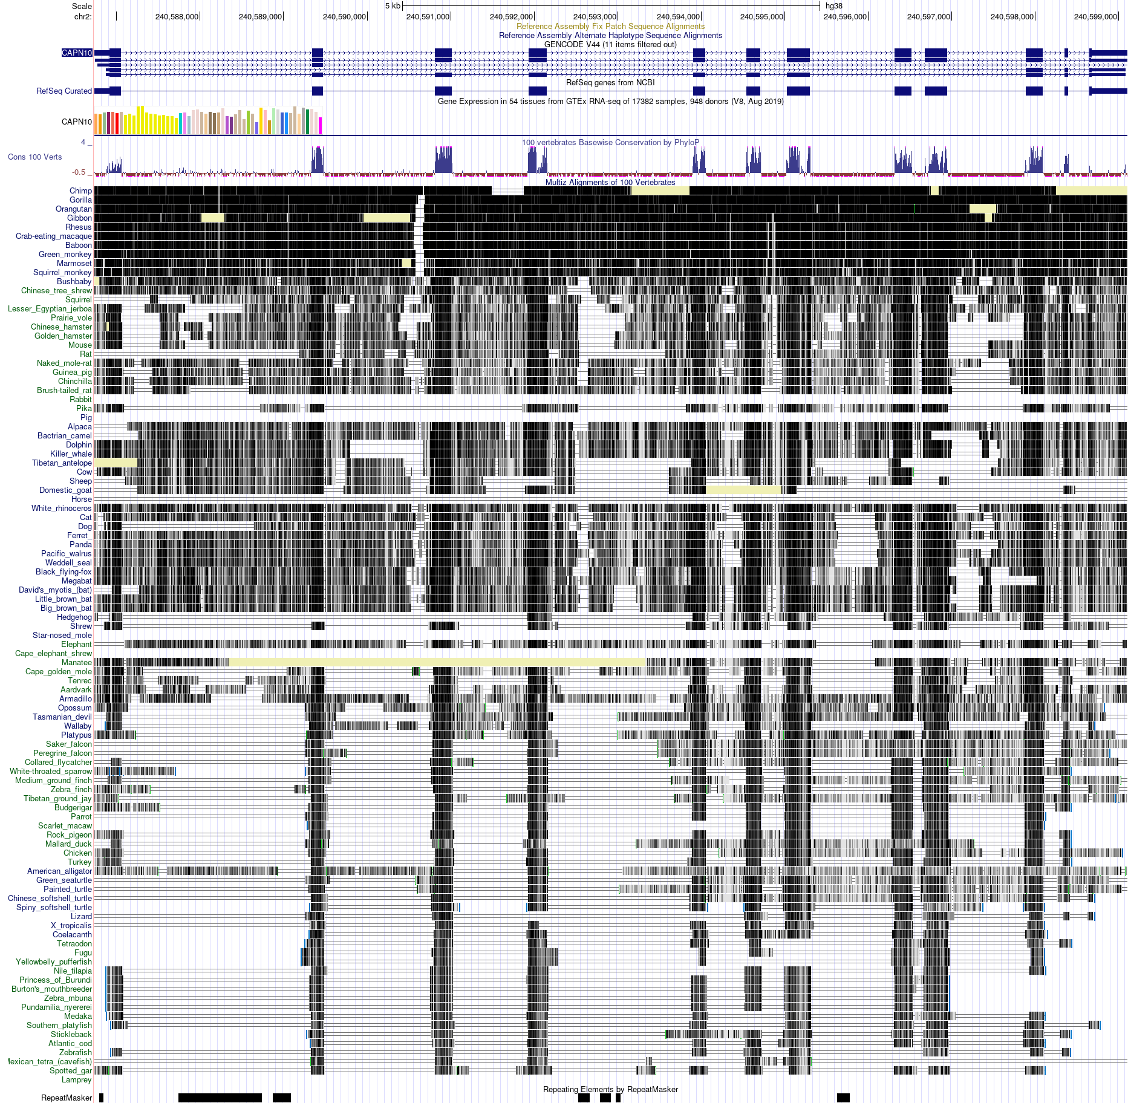
CAPN10 gene is well conserved across species

Slide 22

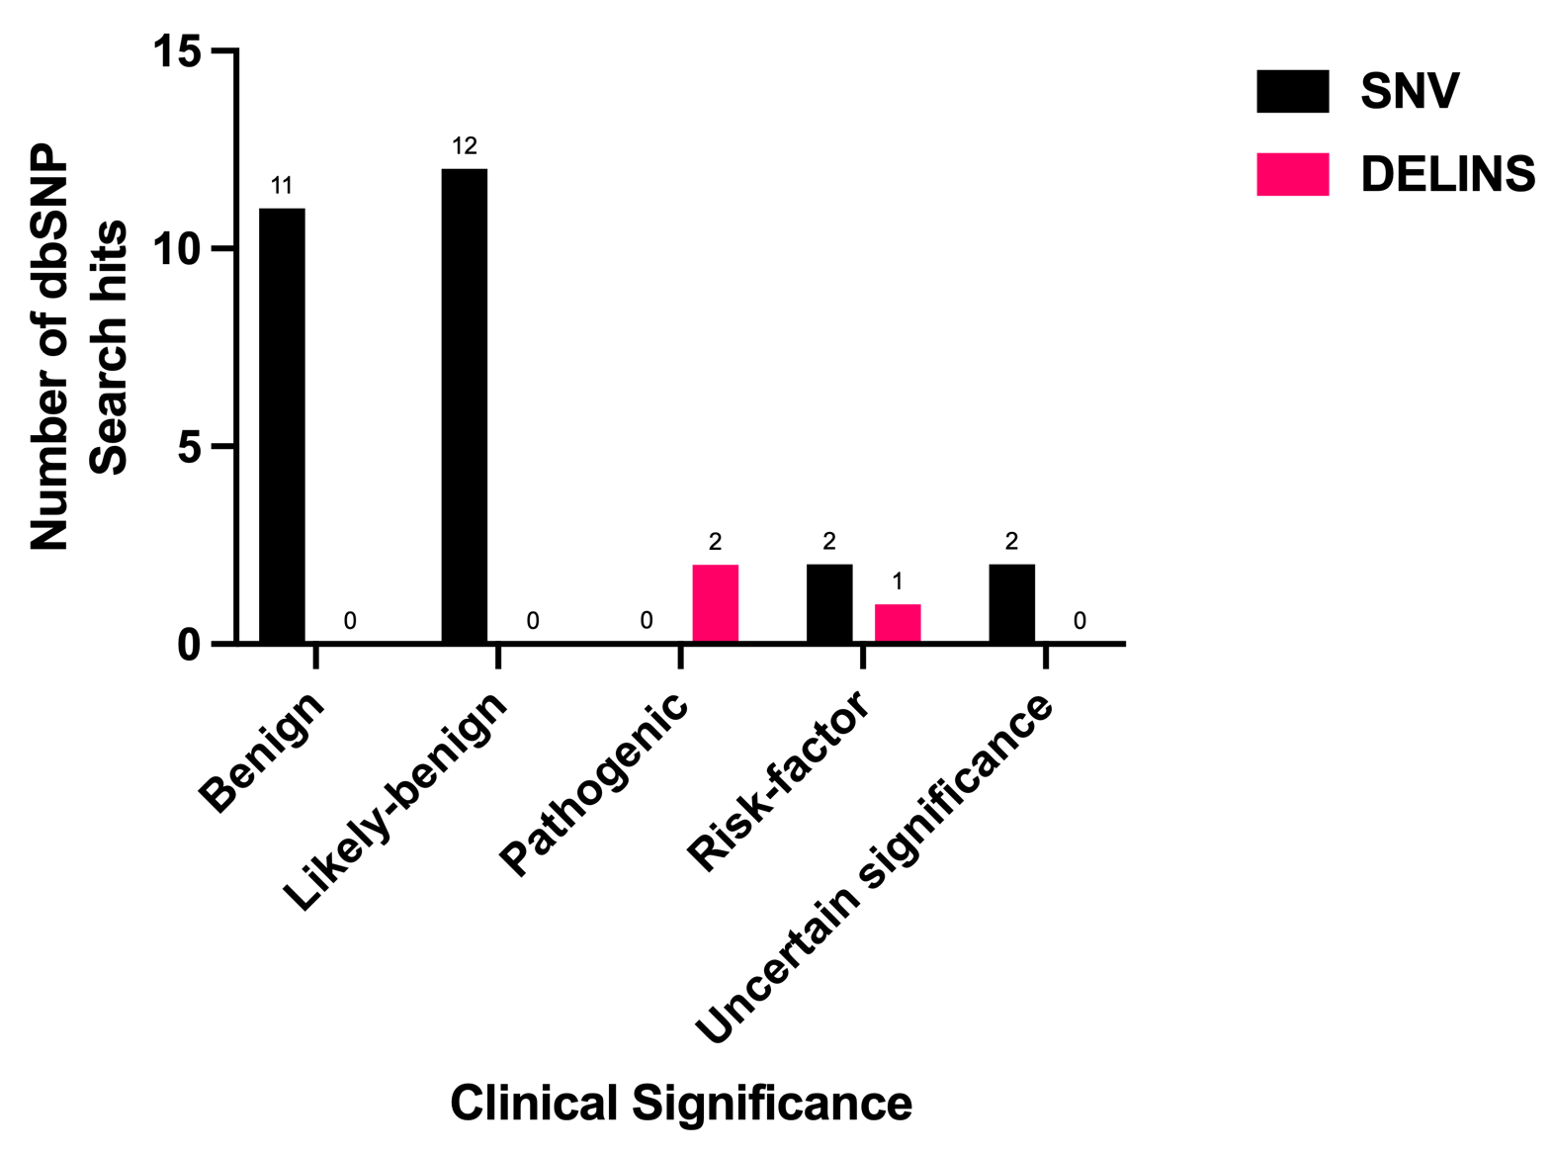
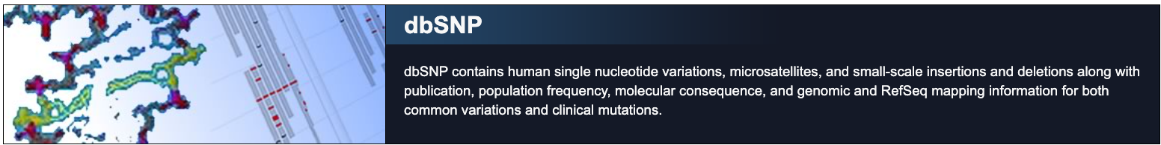

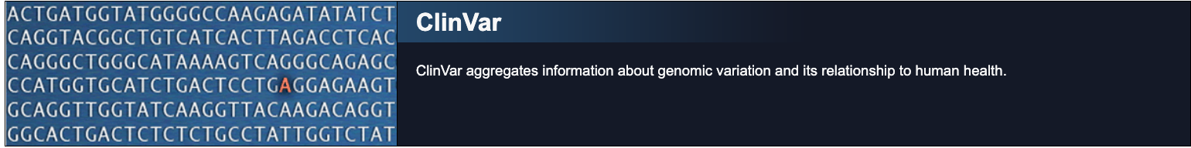
Genetic Variations in CAPN10: SNP
“CAPN10 AND Homo sapiens”
6922 results
Clinical Significance
30 results
SNV- Single nucleotide variations
DELINS- deletion and insertions
Created with GraphPad Prism 10.1.1

Slide 23
Variant type | Snp_id | Clinical significance | ClinVar Accession ID | Clinvar Conditions
delins | 1559425580 | pathogenic | VCV000984989.2 | Inborn genetic conditions
delins | 1182803771 | pathogenic | data not found | data not found
delins | 3842570 | risk-factor | VCV000005094.4 | Type 2 diabetes mellitus 1, susceptibility to
snv | 3792267 | risk-factor | VCV000005093.5 | Type 2 diabetes mellitus 1, susceptibility to
snv | 2975760 | risk-factor | VCV000005096.5 | Polycystic ovary syndrome, susceptibility to; Type 2 diabetes mellitus 1, susceptibility to

Slide 24
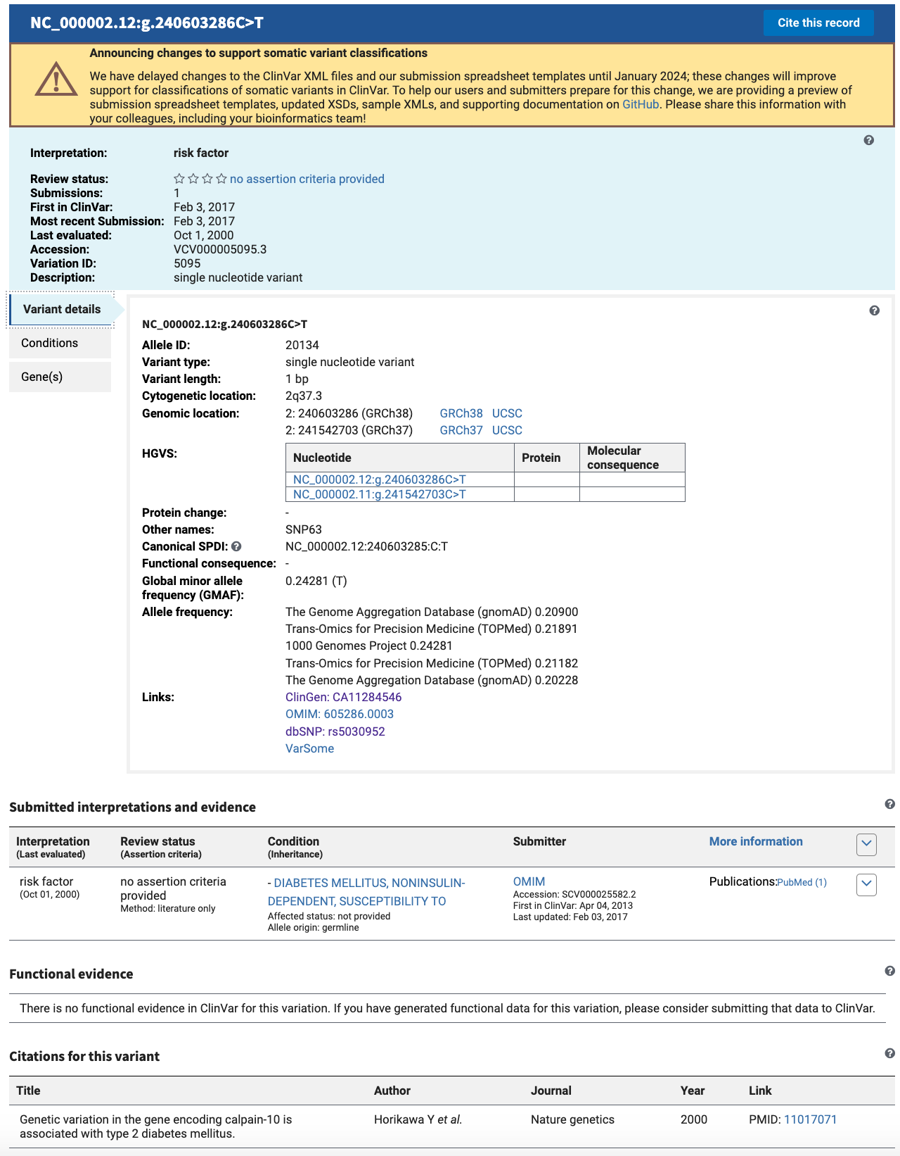
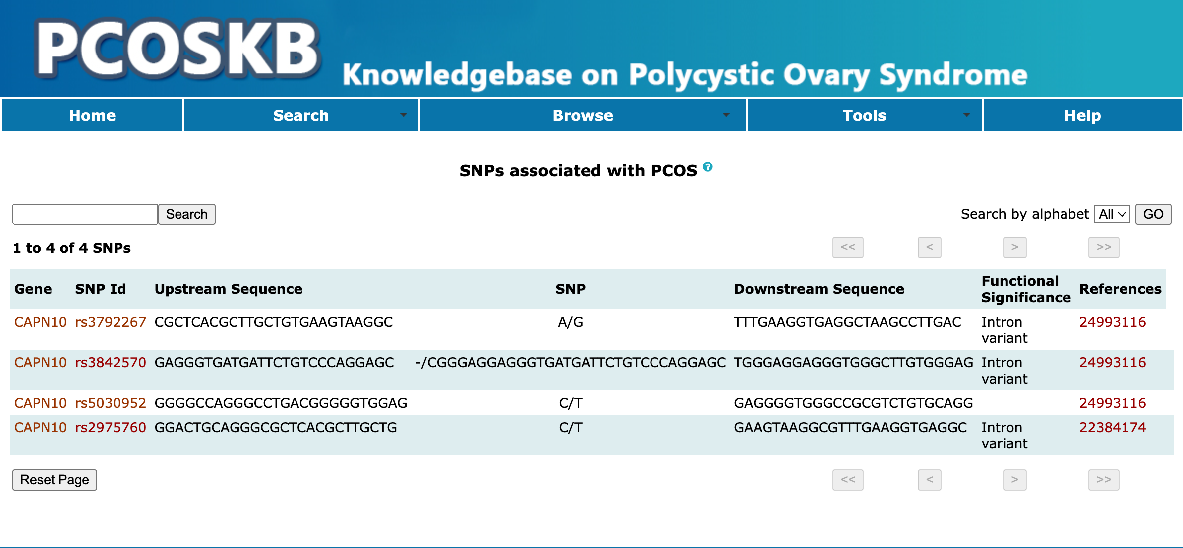
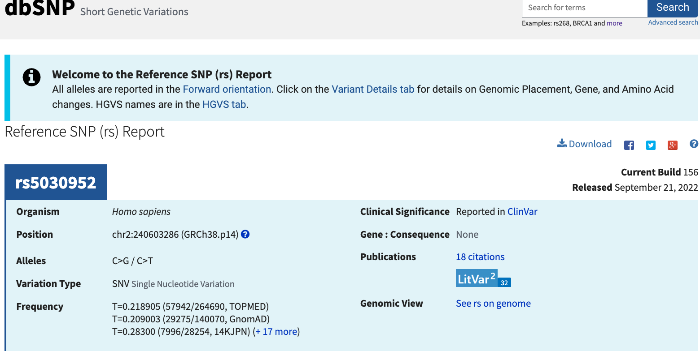
4 SNP’s in CAPN10 gene is associated with Type. 2 Diabetes
1 SNP noted with PCOS and Type 2 Diabetes
No incidence of the term Insulin resistance
Joseph,S., Barai,R.S., Bhujbalrao,R. and Idicula-Thomas,S. (2016) PCOSKB: A KnowledgeBase on genes, diseases, ontology terms and biochemical pathways associated with PolyCystic Ovary Syndrome. Nucleic Acids Res., 44, D1032–D1035.

Slide 25
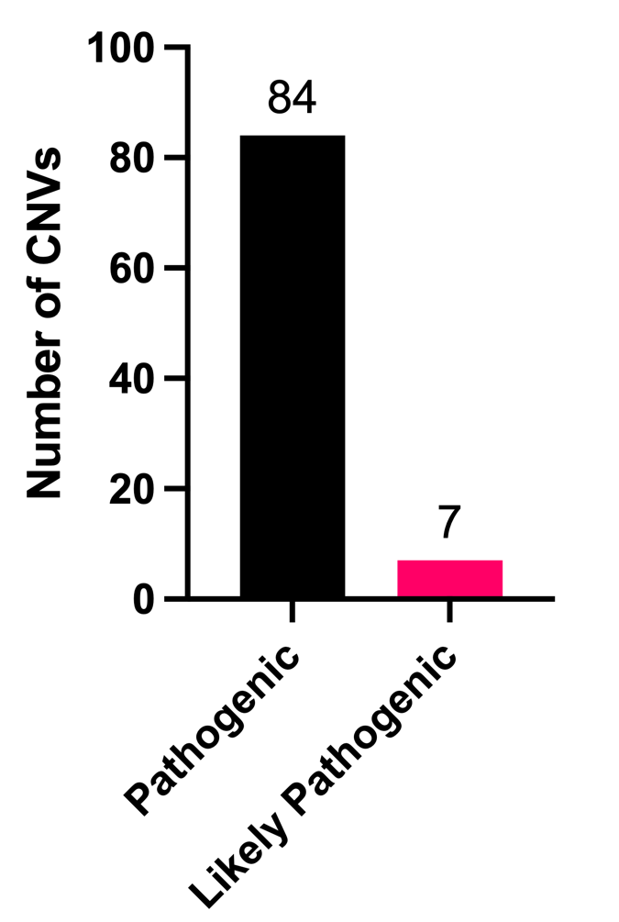
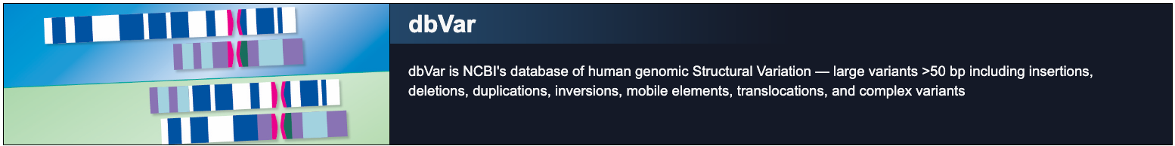
Genomic Structural Variations in CAPN10:
“CAPN10 AND Homo sapiens”
Relation between 91 CNVs in CAPN10 gene and PCOS, Type 2 Diabetes and IR remains to be investigated
354 results
Clinical Significance
Pathogenic or Likely Pathogenic
91 results
CNV-Copy Number Variations
Created with GraphPad Prism 10.1.1

Slide 26
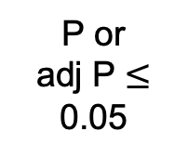
NCBI GEO: Differential Expression Analysis
PCOS with IR
Healthy Controls
GEOQuery RPackage
GDS3104
GDS4133
GDS4399
GEO ID | Gene | Nucleotide.Title | logFC | AveExpr | P.Value | adj.P.Val
GDS3104 | CAPN10 | Homo sapiens calpain 10 (CAPN10), transcript variant 1, mRNA | -0.079428623 | 7.404371443 | 0.447657316 | 0.817949449
GDS4133 | CAPN10 | Homo sapiens calpain 10 (CAPN10), transcript variant 1, mRNA | 0.091858604 | 7.742038328 | 0.395067046 | 0.606698613
GDS4399 | CAPN10 | Homo sapiens calpain 10 (CAPN10), transcript variant 1, mRNA | 1.940137935 | 7.121850684 | 0.010174355 | 0.479233975
DE limma RPackage
PCOS
vs
Control
Filter DEGs
P or
adj P $≤$ 0.05
No Functional Enrichment Analysis
Screen for CAPN10 gene
https://bioconductor.org/packages/release/bioc/html/GEOquery.html
https://bioconductor.org/packages/release/bioc/html/limma.html

Slide 27
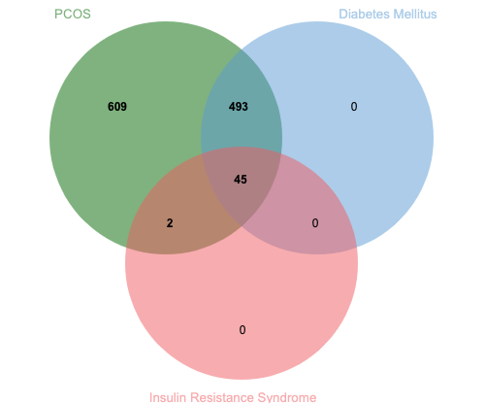
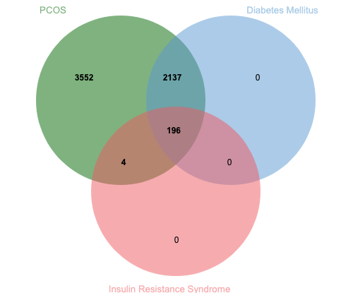
PCOSKB Functional Enrichment Analysis
Pathways
Ontologies
Insulin processing
Insulin receptor recycling
Insulin receptor signaling cascade
Insulin resistance
Insulin secretion
Insulin signaling pathway
IRS activation
Insulin binding
Insulin receptor binding
Insulin receptor complex
Insulin receptor signaling pathway
Insulin receptor substrate binding
Insulin-activated receptor activity
Insulin-like growth factor I binding
Insulin-like growth factor II binding
Insulin-like growth factor receptor binding
Thyroid hormone synthesis
Thyroxine biosynthesis
Hydrogen peroxide catabolic process
Thyroid hormone generation
Hormone biosynthetic process
Iodide peroxidase activity
Joseph,S., Barai,R.S., Bhujbalrao,R. and Idicula-Thomas,S. (2016) PCOSKB: A KnowledgeBase on genes, diseases, ontology terms and biochemical pathways associated with PolyCystic Ovary Syndrome. Nucleic Acids Res., 44, D1032–D1035

Slide 28
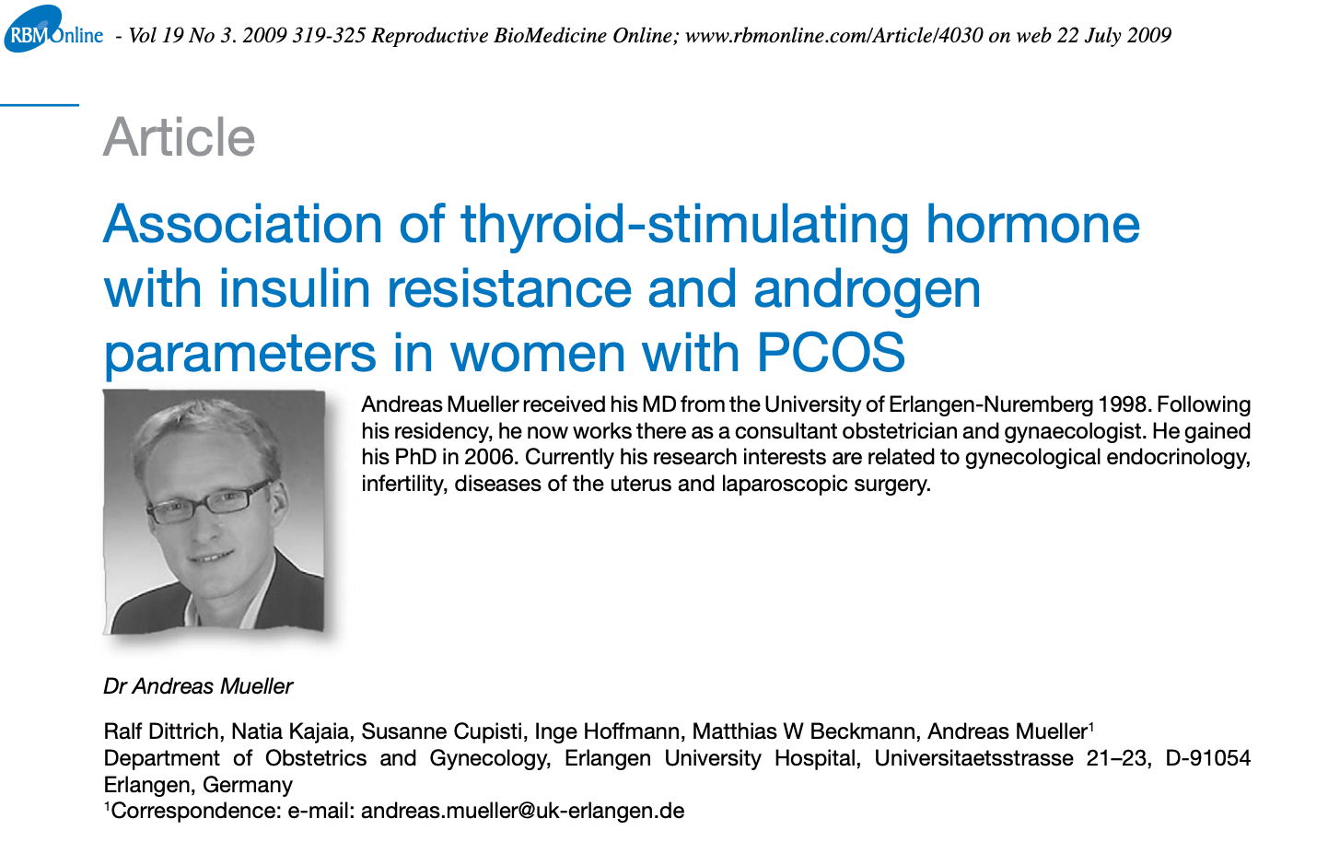
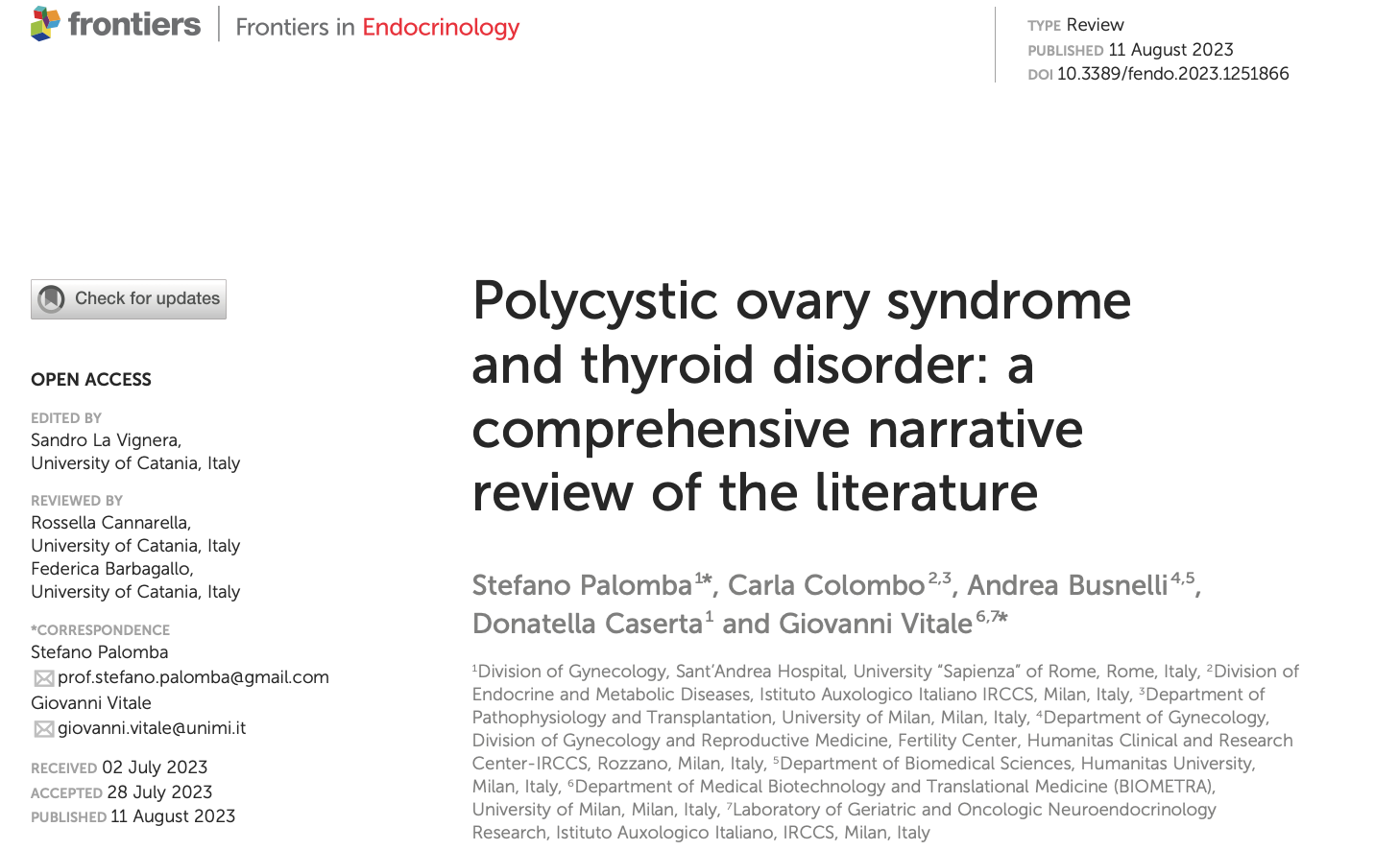
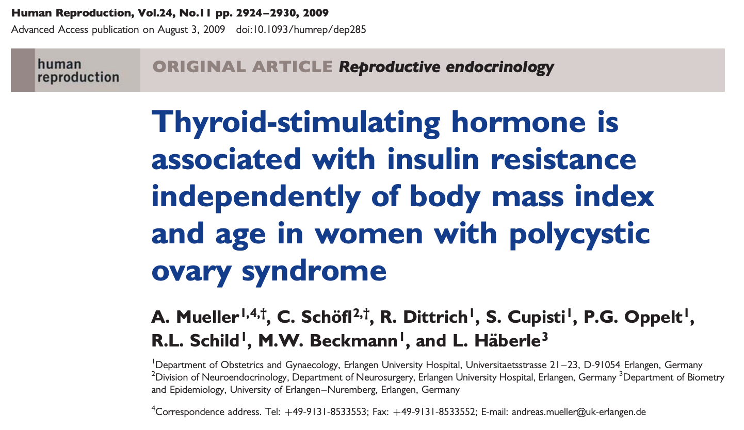
CAPN10?
PCOS
Thyroid functions
IR

Slide 29
Summary
CAPN10 Human Tissue Expression
Expressed across wide variety of tissues
Low tissue specificity
Inter-species Conservation of CAPN10
Exonic regions well conserved
Intronic regions well conserved in Non-human primates
Genetic and Structural variations in CAPN10
1 SNP identified in relation to PCOS and Type 2 Diabetes
3 SNPs identified in relation to Type 2 Diabetes
No “Insulin-resistance” or “Insulin-resistant syndrome” terminologies
91 CNVs with pathogenic clinical significance identified
None had any clinical condition relevance
GEO Differential Expression Analysis
CAPN10 gene was not a significant DEG in three different PCOS with IR datasets
PCOSKB Functional Enrichment Analysis
Thyroid hormone related terms enriched between PCOS and IR
45 pathways and 196 ontologies common to all 3 conditions
No commonalities between IR and Diabetes

Slide 30
Take-Home Messages
CAPN10 gene and IR is highly conserved well across species
Exclusive human specificity of PCOS poses a compelling avenue for future research exploration from an evolutionary perspective
Clinical significance and relevance to PCOS associated conditions for CAPN10 genomic structural variants remains to be established
Current PCOS databases provide an insight into possible interlinks between PCOS, IR and Diabetes for future therapeutic interventions and research, but needs to be updated
More transcriptomic studies needed to evaluate expression trends of CAPN10 and other related genes in the context of PCOS, Insulin resistance and Diabetes
Is CAPN10 involved in the relationships between PCOS, IR and thyroid functions?

Slide 31
Thank you!
Contact: Canvas or Meena.Easwaran@uth.tmc.edu

